Slide 1
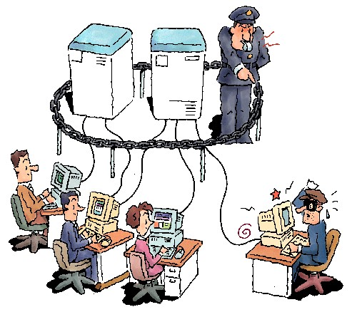
Database and Application Security
S. Sudarshan
Computer Science and Engg. Dept
I.I.T. Bombay
Database and Application Security, Nov 2006

Slide 2



Database Security
Database Security - protection from malicious attempts to steal (view) or modify data.
Database and Application Security, Nov 2006

Slide 3
Importance of Data
Bank/Demat accounts
Credit card, Salary, Income tax data
University admissions, marks/grades
Land records, licenses
Data = crown jewels for organizations
Recent headlines:
  Personal information of millions of credit card users stolen
    Laws on privacy in the US
    Theft of US data in India
  Criminal gangs get into identity theft
  Earlier this year in Mumbai
    Hackers steal credit card data using card reader and make fraudulent purchases
    Hacker creates fake Web site to phish for credit card information
  Auto-rickshaw license fraud in New Delhi
Database and Application Security, Nov 2006

Slide 4


Identity Theft
Pretend to be someone else and get credit cards/loans in their name
  Identification based on “private” information that is not hard to obtain online
More lucrative than blue-collar crime,
  harder to catch criminals
Hurts victims even more than regular theft
  Onus goes on innocent people to prove they didn’t get loans or make credit card payment
  Credit history gets spoilt, making it harder to get future loans
  And you may have been robbed without ever knowing about it.
Increasing risk in India
  PAN numbers, names available online
Database and Application Security, Nov 2006

Slide 5
What me worry?
“Bad things only happen to other people.”??
  SQL/Slammer
    Attacked SQLServer, brought networks down all over the world (including IITB)
    Luckily no data lost/stolen
  Flaw in registration script at database security workshop at IIT Bombay
    Careless coding exposed database password to outside world
Most Web applications vulnerable to SQL injection attacks
Database and Application Security, Nov 2006

Slide 6
Overview
Levels of data security
Authorization in databases
Application Vulnerabilities
Summary and References
Database and Application Security, Nov 2006

Slide 7
Levels of Data Security
Human level: Corrupt/careless User
Network/User Interface
Database application program
Database system
Operating System
Physical level
Database and Application Security, Nov 2006

Slide 8
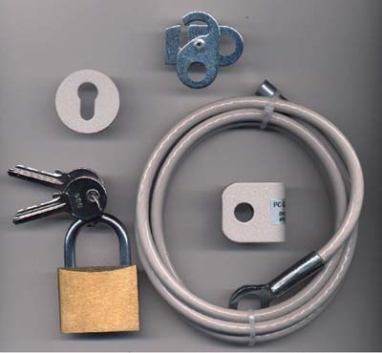
Physical/OS Security
Physical level
  Traditional lock-and-key security
  Protection from floods, fire, etc.
    E.g. WTC (9/11), fires in IITM, WWW conf website, etc.
  Protection from administrator error
    E.g. delete critical files
  Solution
    Remote backup for disaster recovery
    Plus archival backup (e.g. DVDs/tapes)
Operating system level
  Protection from virus/worm attacks critical
Database and Application Security, Nov 2006

Slide 9
Database Encryption
E.g. What if a laptop/disk/USB key with critical data is lost?
Partial solution: encrypt the database at storage level, transparent to application
    Whole database/file/relation
      Unit of encryption: page
    Column encryption
  Main issue: key management
    E.g. user provides decryption key (password) when database is started up
  Supported by many database systems
    Standard practice now to encrypt credit card information, and other sensitive information
Database and Application Security, Nov 2006

Slide 10

Security (Cont.)
Network level: must use encryption to prevent
  Eavesdropping: unauthorized reading of messages
  Masquerading:
    pretending to be an authorized
    user or legitimate site, or
    sending messages supposedly
    from authorized users
Database and Application Security, Nov 2006

Slide 11
Network Security
All information must be encrypted to prevent eavesdropping
  Public/private key encryption widely used
  Handled by secure http - https://
Must prevent person-in-the-middle attacks
  E.g. someone impersonates seller or bank/credit card company and fools buyer into revealing information
    Encrypting messages alone doesn’t solve this problem
    More on this in next slide
Database and Application Security, Nov 2006

Slide 12
Site Authentication
Digital certificates are used in https to prevent impersonation/man-in-the middle attack
  Certification agency creates digital certificate by encrypting, e.g., site’s public key using its own private key
    Verifies site identity by external means first!
  Site sends certificate to buyer
  Customer uses public key of certification agency to decrypt certificate and find sites public key
    Man-in-the-middle cannot send fake public key
  Sites public key used for setting up secure communication
Database and Application Security, Nov 2006

Slide 13

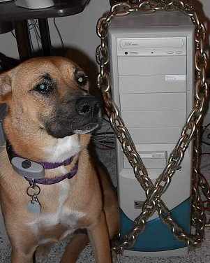
Security at the Database/Application Program
Authentication and authorization mechanisms to allow specific users access only to required data
Authentication: who are you? Prove it!
Authorization: what you are allowed to do
Database and Application Security, Nov 2006

Slide 14

Database vs. Application
Application authenticates/authorizes users
Application itself authenticates itself to database
  Database password
Application
Program
Database
Database and Application Security, Nov 2006

Slide 15
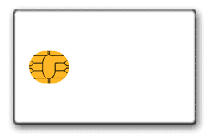
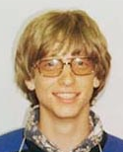
User Authentication
Password
  Most users abuse passwords. For e.g.
    Easy to guess password
    Share passwords with others
Smartcards
  Need smartcard
  + a PIN or password
Bill Gates
Database and Application Security, Nov 2006

Slide 16
User Authentication
Central authentication systems allow users to be authenticated centrally
  LDAP or MS Active Directory often used for central authentication and user management in organizations
Single sign-on: authenticate once, and access multiple applications without fresh authentication
  Microsoft passport, PubCookie etc
  Avoids plethora of passwords
  Password only given to central site, not to applications
Database and Application Security, Nov 2006

Slide 17
Overview
Levels of security
Authorization in databases
Application Vulnerabilities
References
Database and Application Security, Nov 2006

Slide 18
Authorization
Different authorizations for different users
  Accounts clerk vs.
  Accounts manager vs.
  End users
Database and Application Security, Nov 2006

Slide 19


Database/Application Security
Ensure that only authenticated users can access the system
And can access (read/update) only data/interfaces that they are authorized to access
Database and Application Security, Nov 2006

Slide 20
Limitations of SQL Authorization
SQL does not support authorization at a tuple level
  E.g. we cannot restrict students to see only (the tuples storing) their own grades
Web applications are dominant users of databases
  Application end users don't have database user ids, they are all mapped to the same database user id
  Database access control provides only a very coarse application-level access control
Database and Application Security, Nov 2006

Slide 21
Access Control in Application Layer
Applications authenticate end users and decide what interfaces to give to whom
  Screen level authorization: which users are allowed to access which screens
  Parameter checking: users only authorized to execute forms with certain parameter values
    E.g. CSE faculty can see only CSE grades
Database and Application Security, Nov 2006

Slide 22
Access Control in Application Layer
Authorization in application layer vs. database layer
  Benefits
    fine grained authorizations, such as to individual tuples, can be implemented by the application.
    authorizations based on business logic easier to code at application level
  Drawback:
    Authorization must be done in application code, and may be dispersed all over an application
    Hard to check or modify authorizations
    Checking for absence of authorization loopholes becomes very difficult since it requires reading large amounts of application code
  Need a good via-media
Database and Application Security, Nov 2006

Slide 23
Oracle Virtual Private Database
Oracle VPD
  Provides ability to automatically add predicates to where clause of SQL queries, to enforce fine-grained access control
    E.g. select * from grades becomes
    select * from grades where rollno=userId()
  Mechanism:
    DBA creates an authorization function. When invoked with a relation name and mode of access, function returns a string containing authorization predicate
    Strings for each relation and-ed together and added to user’s query
  Application domain: hosted applications, where applications of different organizations share a database (down to relation level)
    Added predicates ensures each organization sees only its own data
Database and Application Security, Nov 2006

Slide 24

Privacy
Aggregate information about private information can be very valuable
  E.g. identification of epidemics, mining for patterns (e.g. disease causes) etc.
Privacy preserving data release
  E.g. in US, many organizations released “anonymized” medical data, with names removed, but zipcode (= pincode), sex and date of birth retained
    Turns out above (zipcode,sex,date of birth) uniquely identify most people!
      Correlate anonymized data with (say) electoral data with same information
  Recent problems at America Online
    Released search history, apparently anonymized, but users could be easily identified in several cases
      Several top officials were fired
  Earlier problems revealed medical history of
  Massachusetts state governer.
Not yet a criminal issue, but lawsuits have happened
Conflict with Right To Information Act
  Many issues still to be resolved
Database and Application Security, Nov 2006

Slide 25
Overview
Levels of security
Authorization in databases
Application Vulnerabilities
References
Database and Application Security, Nov 2006

Slide 26
Application Security
Applications are often the biggest source of insecurity
  Poor coding of application may allow unauthorized access
  Application code may be very big, easy to make mistakes and leave security holes
  Very large surface area
    Used in fewer places
      Some security by obfuscation
      Lots of holes due to poor/hasty programming
Database and Application Security, Nov 2006

Slide 27
OWASP Top 10 Web Security Vulnerabilities
Unvalidated input
Broken access control
Broken account/session management
Cross-site scripting (XSS) flaws
Buffer overflows
(SQL) Injection flaws
Improper error handling
Insecure storage
Denial-of-service
Insecure configuration management
Database and Application Security, Nov 2006
Notes:
Open Web Application Security Project (OWASP)

Slide 28
SQL Injection
E.g. application takes accnt_number as input from user and creates an SQL query as follows:
  string query = "select balance from account where account_number =‘" + accnt_number +"‘"
  Suppose instead of a valid account number, user types in
    ‘; delete from r;
    then (oops!) the query becomes
    select balance from account where account_number =‘ ‘; delete from r;
Hackers can probe for SQL injection vulnerability by typing, e.g. ‘*** in an input box
  Tools can probe for vulnerability
  Error messages can reveal information to hacker
Database and Application Security, Nov 2006

Slide 29
Preventing SQL Injection
To prevent SQL injection attacks use prepared statements (instead of creating query strings from input parameters)
  PreparedStatement pstmt= conn.prepareStatement(
  "select balance from account where account_number =?“);
  pstmt.setString(1,accnt_number);
  pstmt.execute();
    (assume that conn is an already open connection to the database)
Alternatives:
  use stored procedures
  use a function that removes special characters (such as quotes) from strings
Database and Application Security, Nov 2006

Slide 30
Passwords in Scripts
E.g.: file1.jsp (or java or other source file) located in publicly accessible area of web server
  Intruder looks for http://<urlpath>/file1.jsp~
    or .jsp.swp, etc
  If jsp has database userid/password in clear text, big trouble
    Happened at IITB
Morals
  Never store scripts (java/jsp) in an area accessible to http
  Never store passwords in scripts, keep them in config files
  Never store config files in any web-accessible areas
  Restrict database access to only trusted clients
    At port level, or using database provided functionality
Database and Application Security, Nov 2006

Slide 31

Outsider vs. Insider Attack
Most security schemes address outsider attack
Have password to database? Can update anything
  Bypassing all application level security measures
    More people with access → more danger
Application program has database password
Great deal of trust in people who manage databases
  Risk of compromise greater with value of data
  Happened with auto-rickshaw registration in New Delhi
Database and Application Security, Nov 2006

Slide 32
Protecting from Users
Multi-person approval:
  Standard practice in banks, accounts departments
  Encoded as part of application workflow
  External paper trail
Strong authentication of users
  Smart cards
Careful allocation of authorizations on a need to use basis
  Practical problem: absence of a user should not prevent organization from functioning
  Many organizations therefore grant overly generous authorizations
Database and Application Security, Nov 2006

Slide 33
Protecting from Programmers/DBA
Have password to database, can update anything!
  Digital signatures by end users can help in some situations
    E.g. low update rate data such as land records, birth/death data
Application program has database password
  Seize control of the application program ➔ can do anything to the database
  Solution:
    Don’t give database password to development team
    keep password in a configuration file on live server, accessible to only a few system administrators
Ongoing research on trusted applications
  E.g. OS computes checksum on application to verify corruption
  Allows file-system access only to trusted applications
Database and Application Security, Nov 2006

Slide 34
Protection from admin/super-users
Operating system administrators (also known as super-users) can do anything they want to the database.
  Small number of trusted administrators
What if a laptop with critical data is lost?
  Encrypt entire database (and/or file system)
  Supported, e.g. in SQL Server 2005
  Authentication (password/smart card) when database is started up
Database and Application Security, Nov 2006

Slide 35
Detecting Corruption
Audit trails: record of all (update) activity on the database: who did what, when
  Application level audit trail
    Helps detect fraudulent activities by users
    Independent audit section to check all updates
    BUT: DBAs can bypass this level
      E.g. audit trail apparently deleted in New Delhi auto-rickshaw license case by malicious users with DBA access
  Database level audit trail
    Database needs to ensure these can’t be turned off, and turned on again after doing damage
    Supported by most commercial database systems
    But required DBAs with knowledge of application to monitor at this level
  Keep archival copies and cross check periodically
Database and Application Security, Nov 2006

Slide 36


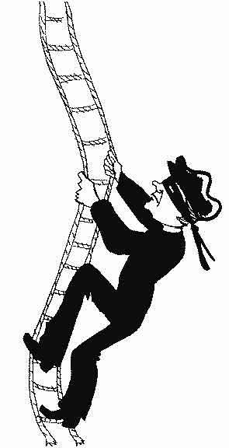
Information Leakage
So you thought only the query result matters?
Database and Application Security, Nov 2006

Slide 37
Information Leakage via UDFs
Auth view myemployee: only those employee whose dept_id is in A1
Query:
select * from employee
where myudf(salary)
Final query plan is not safe
  UDF may be pushed down in plan, and executed on unauthorized intermediate result
  As a side-effect, UDF may expose values passed to it [Litchfield]
  Can be partly solved using sandboxing
σ_{myudf(E.salary)}
σ_{myudf(E.salary)}
σ_{myudf(E.salary)}
A1
myemployees
employees
A1
employees
Database and Application Security, Nov 2006
Notes:
user-defined functions (UDFs)

Slide 38
Other channels of information leakage
Exceptions, Error Messages
  Query: select * from employee
  where 1/(salary-100K) = 0.23
  Query plan: Selection condition in query gets pushed below authorization semi-join
  Divide by zero exception if salary = 100K
  Reveals that employee has salary = 100K
Timing Analysis
  Sub-query can perform an expensive computation only if certain tuples are present in its input
To prevent leakage, treat all channels as unsafe operations
Database and Application Security, Nov 2006

Slide 39
Preventing Information Leakage via UDFs
UDF on Top: Keep UDFs at the top of query plan
  Definitely safe, no information leakage
  Better plans possible if UDF is selective
Optimal Safe plan
  When is a plan safe?
  How to search for optimal safe plan?
  For details, see: Kabra et al., SIGMOD 2006
σ_{myudf(E.salary)}
σ_{myudf(E.salary)}
A1
employees
employees
A1
Database and Application Security, Nov 2006
Notes:
While UDFonTop obviously prevents information leakage via UDFs, we are not satisfied.
We are now thinking is that the cheapest plan for this query?
Probably not. If UDF happens to be very selective, keeping the UDF on top is not the best choice.
Therefore, we now want to find the optimal safe plan. For this, we need to first characterize when is a query plan safe?
In other words, how do we know if the UDF placement in a certain alternative plan cannot leak any information?
Once we define the space of plans that are guaranteed to be safe with respect to UDFs, we would like to modify the existing
Optimizer to search for an optimal plan within this search space.

Slide 40
Overview
Levels of security
Authorization in databases
Application Vulnerabilities
Summary
Database and Application Security, Nov 2006

Slide 41
Summary
Data security is critical
Requires security at different levels
Several technical solutions
But human training is essential
Database and Application Security, Nov 2006

Slide 42
Acknowledgments
Pictures in this talk stolen from various web sources!
Database and Application Security, Nov 2006

Slide 43
References
(Shameless advertisement!) Chapter 8 of Database System Concepts 5th Edition, Silberschatz, Korth and Sudarshan, McGraw-Hill
The Open Web Application Security Project
  http://www.owasp.org
Web application security scanners
  e.g. WebInspect (SPI Dynamics)
  http://www.windowsecurity.com/software/Web-Application-Security/
SQL Injection
  http://www.cgisecurity.com/development/sql.shtml
9 ways to hack a web app
  http://developers.sun.com/learning/javaoneonline/2005/webtier/TS-5935.pdf
Related research papers
  Kabra, Ramamurthy and Sudarshan, Redundancy and Information Leakage in Fine-Grained Access Control, SIGMOD 2006
  Rizvi, Mendelzon, Sudarshan and Roy, Extending Query Rewriting Techniques for Fine-Grained Access Control, SIGMOD 2004
Database and Application Security, Nov 2006

Slide 44
Extra Slides
Database and Application Security, Nov 2006

Slide 45
Authorization
Forms of authorization on (parts of) the database:
Read authorization - allows reading, but
not modification of data.
Insert authorization - allows insertion of new data, but not modification of existing data.
Update authorization - allows modification, but not deletion of data.
Delete authorization - allows deletion of data
Database and Application Security, Nov 2006

Slide 46
Security Specification in SQL
The grant statement is used to confer authorization
grant <privilege list>
on <relation name or view name> to <user list>
<user list> is:
  a user-id
  public, which allows all valid users the privilege granted
  A role (more on this later)
Granting a privilege on a view does not imply granting any privileges on the underlying relations.
The grantor of the privilege must already hold the privilege on the specified item (or be the database administrator).
Database and Application Security, Nov 2006

Slide 47
Privileges in SQL
select: allows read access to relation,or the ability to query using the view
  Example: grant users U₁, U₂, and U₃ select authorization on the branch relation:
grant select on branch to U₁, U₂, U₃
insert: the ability to insert tuples
update: the ability to update using the SQL update statement
delete: the ability to delete tuples.
references: ability to declare foreign keys when creating relations.
usage: In SQL-92; authorizes a user to use a specified domain
all privileges: used as a short form for all the allowable privileges
Database and Application Security, Nov 2006

Slide 48
Privilege To Grant Privileges
with grant option: allows a user who is granted a privilege to pass the privilege on to other users.
  Example:
      grant select on branch to U₁ with grant option
    gives U₁ the select privileges on branch and allows U₁ to grant this
    privilege to others
Database and Application Security, Nov 2006

Slide 49
Roles
Roles permit common privileges for a class of users can be specified just once by creating a corresponding “role”
Privileges can be granted to or revoked from roles
Roles can be assigned to users, and even to other roles
SQL:1999 supports roles
      create role teller
      create role manager
      grant select on branch to teller
      grant update (balance) on account to teller
      grant all privileges on account to manager
      grant teller to manager
      grant teller to alice, bob
      grant manager to avi
Database and Application Security, Nov 2006

Slide 50
Revoking Authorization in SQL
The revoke statement is used to revoke authorization.
  revoke<privilege list>
  on <relation name or view name> from <user list> [restrict|cascade]
Example:
  revoke select on branch from U₁, U₂, U₃ cascade
Revocation of a privilege from a user may cause other users also to lose that privilege; referred to as cascading of the revoke.
We can prevent cascading by specifying restrict:
  revoke select on branch from U₁, U₂, U₃ restrict
With restrict, the revoke command fails if cascading revokes are required.
Database and Application Security, Nov 2006

Slide 51
Revoking Authorization in SQL (Cont.)
<privilege-list> may be all to revoke all privileges the revokee may hold.
If <revokee-list> includes public all users lose the privilege except those granted it explicitly.
If the same privilege was granted twice to the same user by different grantees, the user may retain the privilege after the revocation.
All privileges that depend on the privilege being revoked are also revoked.
Database and Application Security, Nov 2006

Slide 52
Secure Payment
Three-way communication between seller, buyer and credit-card company to make payment
  Credit card company credits amount to seller
  Credit card company consolidates all payments from a buyer and collects them together
    E.g. via buyer’s bank through physical/electronic
    check payment
Several secure payment protocols
  E.g. Secure Electronic Transaction (SET)
Database and Application Security, Nov 2006

